Slide 1
Hack the business…. process
bsides Ottawa 2019
Todd schertzing && Austin reid

Slide 2

Whoarewe
Todd schertzing
Xanthus Security inc
Pen tester, forensic analyst, sys admin: ~20 yrs
Windows* junkie
Austin reid
Bank of Canada
Threat Research, PenTEst & VA
EVTX & SYSMON, MITRE ATT&CK and TTPs
Notes:
both

Slide 3

I’m not following…
“A business process or business method is a collection of related, structured activities or tasks by people or equipment which in a specific sequence produce a service or product (serves a particular business goal) for a particular customer or customers.”
Wikipedia - https://en.wikipedia.org/wiki/Business_process
Notes:
todd

Slide 4
Talk format
identifying business logic problems
Review Build Documentation, standard operating procedures and/or interviews
Develop an attack path
can I leverage this to further the goal; is a technical vulnerability required?
Example Scenarios
Trusted Data (case 1)
MFA ALL THE THINGS (Case 2)
Detection
Threat Intel
Telemetry
Methodology & Walkthroughs
Notes:
both

Slide 5
How can this be bad?
what a vulnerability in a business process could be:
built in Poor practice for user experience
Skipping security functionality for ease of the user (MFA)
Insecure or missing safeguards for an interim procedure
File share access is not a vulnerability unless it the folder is important
Accepting a bad risk
Same workstation accessing multiple networks
Notes:
todd

Slide 6


Case 1 – trusted data
application A places files in a network share to be processed by application B
What could go wrong, right?
Network share insecure
application b trusts data implicitly
Notes:
todd

Slide 7
Proof of concept
By analyzing the dataset left in the folder that has ‘everyone’ read permissions we can learn how the receiving applications stack works
Given write permission in this folder, we can manipulate this application to out bidding given the application trusts the data implicitly
Exploitation into the target solution may be possible if technical vulnerabilities exist

Slide 8
Case 2 – mfa all the things
user A logs into application with multi factor authentication, retrieves administrative credential that is valid for X hours, user a logs back into application as an administrator _________________________ and continues working.
What could go wrong, right?
Administrative session should require mfa as well
In this case, the application did not overwrite resident https post requests
Users unaware that data is retained

Slide 9
Poc attack
Not complex!
Something about direct memory access
The thing about not closing browser tabs
Link for project at end of deck

Slide 10
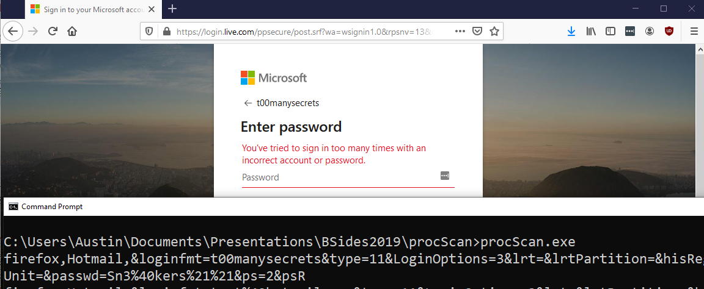
PoC Screenshot

Slide 11
“Prevention is Ideal but Detection is a Must” -Dr. Eric Cole
Not all Vulnerabilities can be resolved via software patches or Configurations
How long will the fix take? (Engineering, Testing, Deployment)
Shouldn't all preventative Controls have detections/logging capabilities?
Sounds like we should build a detection CAPABILITY ☺

Slide 12



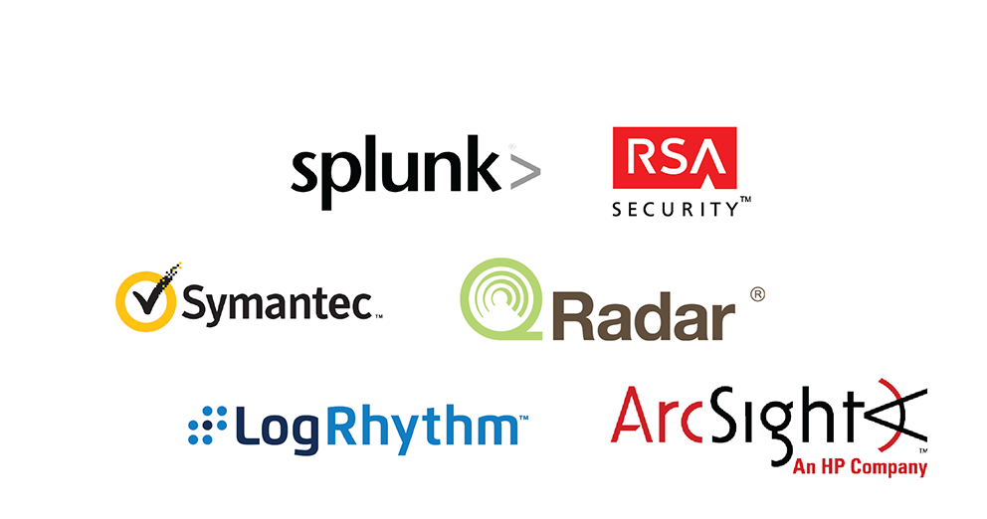

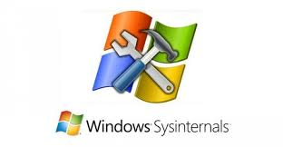
Detection – What’s Required?
Three components to any successful Detection program:
Threat Intelligence - (Tactics, Techniques & Procedures)
Visibility / Instrumentation
Methodology
EVTX
SYSMON
SIEM
TTP Driven Threat Hunting / Detection Engineering

Slide 13
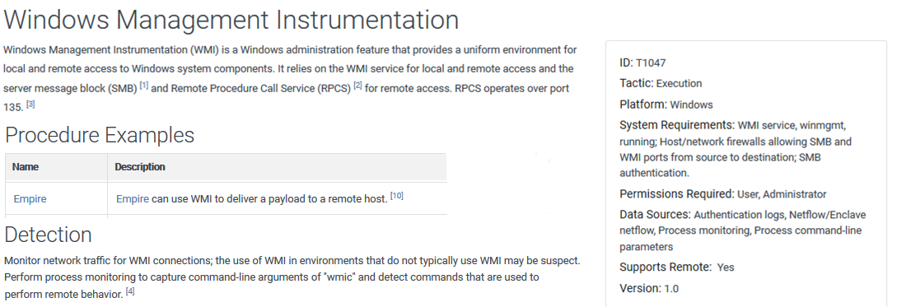
Threat INTEL - MITRE
https://attack.mitre.org/

Slide 14
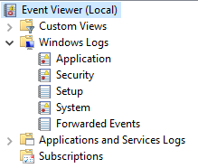
Visibility/ Instrumentation - EVTX
Native Windows Event Logs
Security – Processes, LoGONs, TOKENS/Privs
System – Services
Application – Like the Name implies
Applications And Services – Vista & Above
Powershell
AppLocker
Windows Defender
Requires GPOs to activate Log Categories
@MENASEC1 – MOST WANTED WINDOWS EVENTS
https://docs.google.com/spreadsheets/d/125j4OZlsbRe-5xtBUW_Ak8PvcOWfxKs_fOcSxpLk9Bo/edit#gid=860092912

Slide 15
Visibility/ Instrumentation – SYSMON
SYsINTERNAlS ENHANCEMENT & Compliment TO EVTX
Simple Install & Highly configurable Configuration
Capabilities Continue to Evolve, Highlights include;
IMAGE LOAD
Process ACCESS
Process -> Network
File and Reg WRITE events W/O SACLS
* Not Supported BY MSFT

Slide 16
Threat INTEL - MITRE
https://attack.mitre.org/

Slide 17
Resources: TTP -> Data Sources
Malware Archeology - WINDOWS ATT&CK LOGGING CHEAT SHEET
“This “Windows ATT&CK Logging Cheat Sheet” is intended to help you map the tactics and techniques of the Mitre ATT&CK framework to Windows audit log event IDs in order to know what to collect and harvest, and also what you could hunt for using Windows logging Event IDs.” - https://Windows ATT&CK Logging Cheat Sheet_ver_Sept_2018.pdf
Att&CK DataMap
“A datasource assessment on an event level to show potential coverage of the "MITRE ATT&CK" framework.”
https://medium.com/@olafhartong
https://github.com/olafhartong/ATTACKdatamap

Slide 18


Cyber RANGE – TRAINING Ground
DETECTION LAB
https://github.com/clong/DetectionLab
SHIRE / HUNTING ELK & MORDOR
https://github.com/Cyb3rWard0g/HELK/wiki/Installation
https://blacksmith.readthedocs.io/en/latest/mordor_shire.html
SECURITY ONION
https://github.com/Security-Onion-Solutions/security-onion

Slide 19
TTP driven Threat Hunting Process
Identify the Threat (TTP)
MITRE ATT&CK, Threat Intel, PenTEsting/RED Teaming
Research the Threat – ATT&CK, BLOGS, CODE REVIEW, Google
What is the goal?
How does it work and WHY?
Simulate the Threat (POC) OR OBSERVE NORMAL BEHAVIOR
ART, CALDERA, C2 Framework + Cyber RANGE
Collect and Analyze LoGS and Artifacts
EVTX, SYSMON, EDR, etc.
Prototype your ANALYTIC(s)
Cyber Range SIEM
Tune Your ANALYTIC
Prod SIEM
Document Via the ADS Framework https://github.com/palantir/alerting-detection-strategy-framework

Slide 20
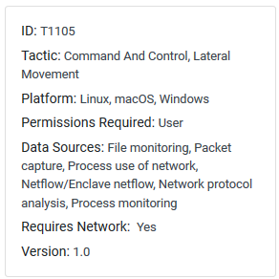
Detecting POC #1
Identify the Threat (TTP)
REMOTE FILE COPY - https://attack.mitre.org/techniques/T1105/
Research the Threat
What is the goal? – Automatic process of copied file
How does it work and WHY? – Open File SHARE ACCESS w/ No Input Validation
Simulate the Threat (POC) & Normal behavior
XCOPY & Powershell
Collect and Analyze LoGS and Artifacts
5145 – Detailed File Share
1 / 4688 – Process Creation
Prototype your ANALYTIC(s)
Tune Your ANALYTIC(S)
Document Via the ADS Framework

Slide 21
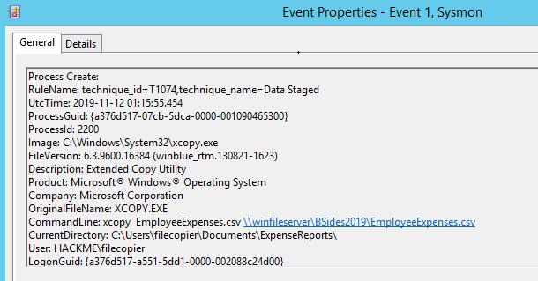

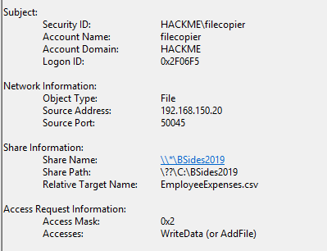
Event Review – Sysmon EID 1 / 5145

Slide 22
Collect and Analyze LoGS and Artifacts POC #1
NORMAL BUSINESS PROCESS via EID 5145 & 1/4688 | MALICIOUS BEHAVIOUR via EID 5145 & 1/4688
Account Name: HACKME\FILECOPIER Logon and Auth Type: Type 3 using Kerberos Source IP: 192.168.150.20 Process/Image Name: xcopy.exe Process Path: C:\Windows\System32\ Command Line: xcopy EmployeeExpenses.csv \\path.. Parent Process & Path: C:\Windows\...\httpd.exe File Path & Name: C:\BSIDES2019\EmployeeExpenses.csv | Account Name: HACKME\ITWASNOTME Logon and Auth Type: Type 3 using Kerberos Source IP: 192.168.150.40 Process Name : powershell.exe Process Path: C:\Windows\System32\WindowsPowerShell\.. Cmd Line: \itwasnotme\Documents\EmployeeExpenses.csv Parent Process & Path C:\Windows\System32\cmd.exe File Path & Name: C:\BSIDES2019\EmployeeExpenses.csv
Lots Of Data points between events, multiple detections
Need to filter 5145 events based on Access Mask=0x2 (Write Data)

Slide 23
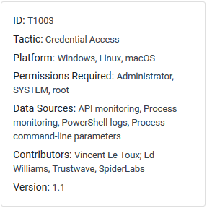
Detecting POC #2
Identify the Threat (TTP)
Credential Dumping (via the Browser) https://attack.mitre.org/techniques/T1003
Research the Threat
What is the goals? – Obtain clear-text credentials from Browser process memory
How does it work and WHY? – One process requests a handle to another IN order to read that processes memory to retrieve password due to no MFA.
Simulate the Threat (POC)
procScan.exe (link at end)
Collect and Analyze LoGS and Artifacts
1 / 4688 – Process Creation
10 – Process Access
Prototype You ANALYTIC(S)
Tune your ANALYTIC(s)
Document Via the ADS Framework

Slide 24
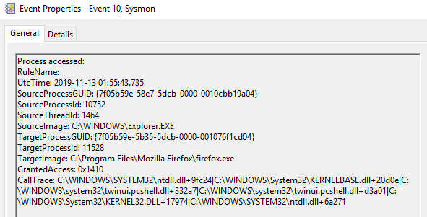
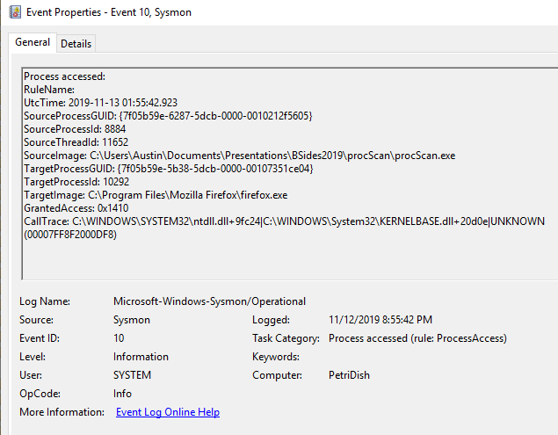
Event Review – Sysmon EID 10

Slide 25
Collect and Analyze LoGS and Artifacts POC #2
OBSERVED BEIGN via EID 4688/1 & 10 | MALICIOUS BEHAVIOUR via EID 4688/1 & 10
Account Name: PETRIDISH\SYSTEM Process Name: Explorer.exe, MRT.exe, MsMpEng.exe, etc. Process Path: C:\Windows; \System32; \ProgramData Granted Access: 0x1410 Call Trace: != String “UNKNOWN” | Account Name: PETRIDISH\Administrator Process Name: procScan.exe Process Path: C:\Users\... Granted Access: 0x1410 Call Trace: String “UNKNOWN”
Similar Behavior to Other Cred Dumping tools such as Invoke-Mimikatz
Additional Detections can be written FOR portable executables
Which user ran the executable?
Rare Executions via SIEM – Not SIGNEd, NO Company NAME
File HASH UPLOAD TO VT
https://cyberwardog.blogspot.com/2017/03/chronicles-of-threat-hunter-hunting-for_22.html

Slide 26
That’s our time – any question?!
Todd – Xanthus Security – https://xanthus.io
Austin – Twitter – https://twitter.com/YouDownWithTTPs
Memparse – https://github.com/XanthusSecurity/memparse
Detection References:
https://docs.google.com/spreadsheets/d/125j4OZlsbRe-5xtBUW_Ak8PvcOWfxKs_fOcSxpLk9Bo/edit#gid=860092912
https://Windows ATT&CK Logging Cheat Sheet_ver_Sept_2018.pdf
https://github.com/olafhartong/ATTACKdatamap
https://github.com/clong/DetectionLab
https://github.com/Cyb3rWard0g/HELK/wiki/Installation
https://blacksmith.readthedocs.io/en/latest/mordor_shire.html
https://github.com/palantir/

Slide 27
EnDPOINT Instrumentation
Windows Event Logs
GPO or Local Security Policies
Include COMMAND LINE in Process creation events
Force Audit Policy Subcategory settings
Increase ETVX file SIZE
SYSMON
XML Config – Supports Many conditions for RULES & filtering
Contains, Contains ANY, CONTAINS ALL, Begins with, ENDS WITH
SUB-RULES with AND/OR
MANY Community DRIVEN SAMPLE CONFIGs
SWIFTONSECURITY, ION-STORM, MODULAR SYSMON
https://github.com/palantir/windows-event-forwarding/blob/master/group-policy-objects/README.md
https://github.com/ion-storm/sysmon-config

